Slide 1
.NET Jump Start
Hands-on-Workshop

Slide 2
Module Tag 2
.NET Jump Start: Tag 2
09:00 – 10:00 | 04 | ASP.NET MVC Grundlagen
10:00 – 12:30 | 04 | Businesslogik und Views zum Verwalten der Posts-Entität (Hands-On)
12:30 – 13:45 | - Mittagspause -
13:45 – 15:00 | 05 | Grundlagen Web APIs und Routing
15:00 – 15:30 | - Kaffeepause -
15:30 – 16:30 | 05 | Entwicklung einer Schnittstelle mit ASP.NET Web API (Hands-On)
16:30 – 17:00 | 05 | Dokumentation und Tests von Web APIs

Slide 3
Kursinhalte
.NET Jump Start
Tag 1 | 01 | Überblick
 | 02 | Vorbereitung und Projektsetup
 | 03 | Datenmodellierung und -abfrage mit dem Entity Framework
Tag 2 | 04 | Aufbau einer Webapplikation mit ASP.NET MVC
 | 05 | Entwicklung einer Schnittstelle mit ASP.NET Web API
Tag 3 | 06 | Entwicklung einer App für Windows Phone

Slide 4
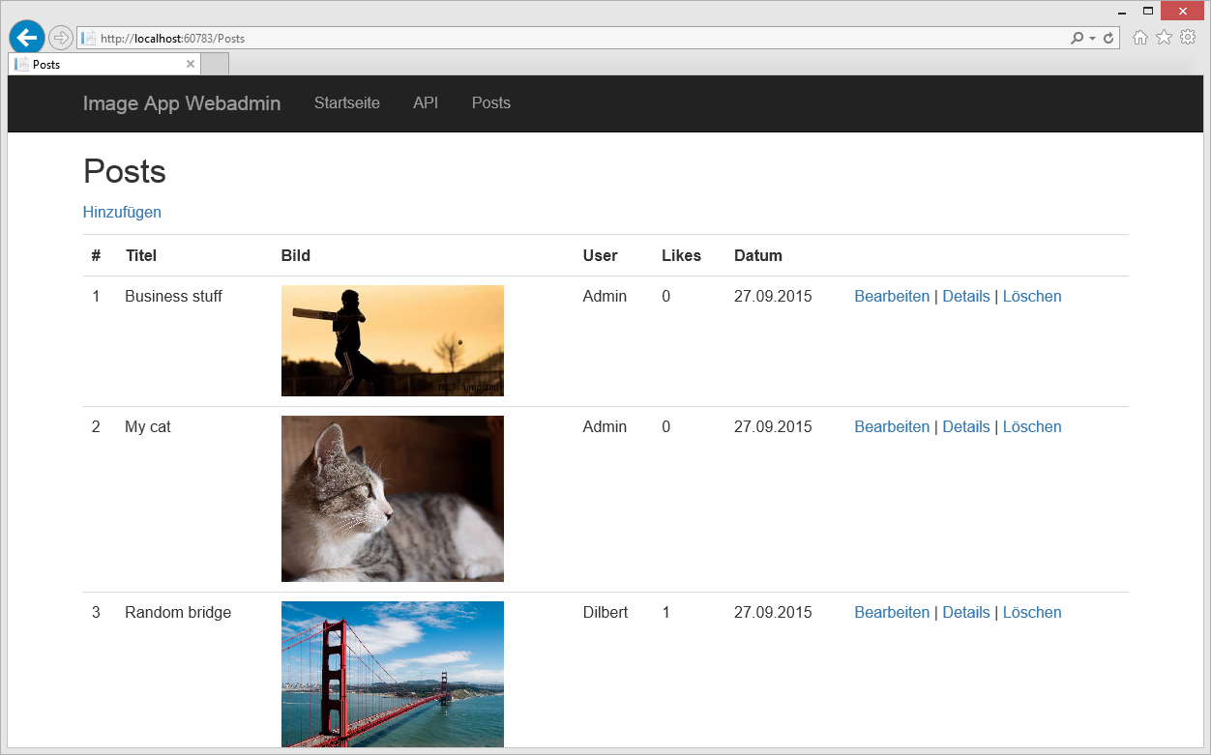
04 | Aufbau einer Webapplikation mit ASP.NET MVC
Benedikt Bergmann

Slide 5
Agenda
MVC
Razor Syntax
Data Annotations
HTML Helpers
Hands-On

Slide 6
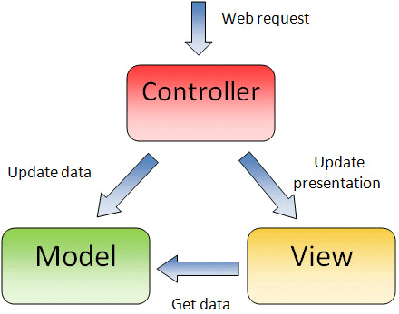
MVC
Trennung von Geschäftslogik, Präsentation und relevanten Daten
“Models” kapseln Objekte und Daten
“Views” genieren die Benutzeroberfläche
“Controllers” interagieren mit Benutzeraktionen
Nur in Visual Studio
Ansonsten MVVM
Code in .cshtml und .cs Dateien
Notes:
The MVC programming model should be new to the audience for this course.
20486A
01: Exploring ASP.NET MVC 4

Slide 7
Razor Syntax
@* Some more Razor examples *@
<span>
Price including Sale Tax: @Model.Price * 1.2
</span>
<span>
Price including Sale Tax: @(Model.Price * 1.2)
</span>
@if (Model.Count > 5)
{
<ol>
@foreach(var item in Model)
{
<li>@item.Name</li>
}
</ol>
}
Notes:
Point out to the students that Razor easily differentiates content from code. For example, even within a Razor code block, when you add an HTML element such as <div>, Razor interprets the text as content. You do not usually need to use the @: delimiter to make this explicit.
Discuss the example code on the slide. Ensure that students understand the HTML that Razor will render.
Question: You want to describe a code block to developers in your view file. You do not want your description to be passed to the browser. What syntax should you use?
Answer: Declare the description as a Razor comment by enclosing it in @* *@ delimiters.
20486A
05: Developing ASP.NET MVC 4 Views

Slide 8
VIEWS AN DATEN BINDEN UND EIGENSCHAFTEN ANZEIGEN
Man kann Views stark typisieren und eine Deklaration eines Models einschließen. Visual Studio erkennt dies und unterstützt u.a. mit IntelliSense Feedback und Error-Handling
@model IEnumerable<MyWebSite.Models.Product>
<h1>Product Catalog</h1>
@foreach (var Product in Model)
{
<div>Name: @Product.Name</div>
}
Notes:
The code example in the slide shows how to use a strongly-typed view when the action controller passes a list of objects of a specific model class.
Question: You want to write a view that displays ten objects of the Photo model class. What model declaration should you use?
Answer: Use a declaration in the following form: @model IEnumerable<projectname/Models/Photo>
20486A
05: Developing ASP.NET MVC 4 Views

Slide 9
Wie kommen die Daten in die VIEW?
Model
Aufruf über View(data)
Stark typisiert
Komplexer
ViewBag
Dynamisch
Alias für ViewData
Perfekt, um einfache Nachrichten an eine View zu senden
Nur für die aktuelle Action verfügbar
Weiterleitungen leeren die ViewBag
TempData
So wie die ViewBag, allerdings bleiben die Daten nach Weiterleitung erhalten

Slide 10
UNTERSCHEIDEN ZWISCHEN SERVERSEITIGEM CODE UND HTML
Razor identifiziert serverseitigen Code, indem es nach dem @ -System Ausschau hält
Unterschiedliche Varianten des @-Symbols
Einfaches @, um serverseitigen Code einzuleiten
@@, um ein @ auf einer HTML-Seite zu rendern
@: um explizit etwas als Text und nicht als Code zu markieren
<text> um explizit mehrere Zeilen als Text und nicht als Code zu markieren
Notes:
Emphasize to the students that Razor is very sophisticated and it rarely misinterprets content and server-side code. Therefore, they will rarely use the @: and <text> delimiters.
Be very clear about the security implications of using Html.Raw() to disable HTML encoding. Emphasize that malicious users regularly test sites for weaknesses. If your use of Html.Raw() does enable script injection, a malicious user is very likely to notice and exploit the weakness.
20486A
05: Developing ASP.NET MVC 4 Views

Slide 11
Data Annotations
public class Photo
{
[DisplayName("Picture")]
public byte[] PhotoFile { get; set; }
[DataType(DataType.MultilineText)]
public string Description { get; set; }
[DataType(DataType.DateTime)]
[DisplayName("Created Date")]
[DisplayFormat(DataFormatString = "{0:dd/MM/yy}"]
public DateTime CreatedDate { get; set; }
}
Notes:
The display and edit data annotations in the slide are enclosed in square brackets. Highlight these annotations to the students and ensure that they can distinguish them from properties and other code.
You will learn about other data annotations, such as validation annotations, later in the course.
Question: In the code on the slide, how can you recognize the display and edit annotations and distinguish them from property code?
Answer: The display and edit annotations are enclosed in square brackets.
20486A
03: Developing ASP.NET MVC 4 Models

Slide 12
VALIDIERUNG VON BENUTZEREINGABEN MIT Data Annotations
public class Person
{
public int PersonID { get; set; }
[Required(ErrorMessage="Please enter a name.")]
public string Name { get; set; }
[Range(0, 400)]
public int Height { get; set; }
[Required]
[DataType(DataType.EmailAddress)]
public string EmailAddress { get; set; }
}
Notes:
Question: You want to make sure that users enter a password that is longer than 6 characters. How could you do this by using a validation data annotation?
Answer: You can use the StringLength validation data annotation to specify this minimum length.
20486A
03: Developing ASP.NET MVC 4 Models

Slide 13
HTML Helpers
Unterstützt das Rendern von HTML-Steuerelementen in einer View
Action Helpers Display Helpers Begin Form Helper Editor Helpers Validation Helpers
Notes:
If you have students who are familiar with Web Forms, you might like to contrast MVC HTML helpers with Web Forms server controls. Helpers perform an analogous role in MVC to the role that server controls play in Web Forms. However, helpers are simpler and lighter-weight. They do not render large blocks of HTML and JavaScript code or ViewState data. Also, they do not support event handlers.
20486A
05: Developing ASP.NET MVC 4 Views

Slide 14
Using Action Helpers
Html.ActionLink()
Url.Action()
@Html.ActionLink("Click here to view photo 1", "Display", new { id = 1 })
<a href="/photo/display/1">
Click here to view photo 1
</a>
<img alt="This image came from an action" src="@Url.Action("GetImage", new { id = 1 })" />
<img alt="This image came from an action" src="/photo/getimage/1" })"
/>
Notes:
The action helpers described in this topic examine the routes defined in your web application to render the correct URLs. Students have not yet learned about the routing engine or how to modify routes. They will learn about routing in Module 7.
Question: You want to render an HTML5 <audio> tag to play a sound file from an action. Would you use the Html.ActionLink() helper or the Url.Action() helper?
Answer: You would use the Url.Action() helper because you are rendering an attribute within the <audio> tag, and not a complete <a> element.
20486A
05: Developing ASP.NET MVC 4 Views

Slide 15
Using Display Helpers
Html.DisplayNameFor()
Html.DisplayFor()
@Html.DisplayNameFor(model => model.CreatedDate)
Created Date
@Html.DisplayFor(model => model.CreatedDate)
28.09.2015
Notes:
Question: You want to ensure that a view displays “This product was last changed on” before the ModifiedDate property. This text is declared in the class with the DisplayName annotation. What code would you write in the view?
Answer: @Html.DisplayNameFor(model => model.ModifiedDate)
20486A
05: Developing ASP.NET MVC 4 Views

Slide 16
The Begin Form Helper
Html.BeginForm()
@using (Html.BeginForm("Create", "Photo", FormMethod.Post, new { enctype = "multipart/form-data" }))
{
@* Place input controls here *@
}
<form action="/Photo/Create" method="post“
enctype="multipart/form-data">
</form>
Notes:
Question: You have created a form with a file selector control that uses the GET method. You have set the enctype attribute to multipart/form-data but when you try to access the file in the action method, an exception is thrown. What have you possibly done incorrectly?
Answer: You must use the POST method to upload files.
20486A
05: Developing ASP.NET MVC 4 Views

Slide 17
Using Editor Helpers
Html.LabelFor()
Html.EditorFor()
@Html.LabelFor(model => model.ContactMe)
<label for="ContactMe"> Contact Me </label>
@Html.EditorFor(model => model.ContactMe)
<input type="checkbox" name="Description">
Notes:
Question: You have a property in the Product model class named ProductID. You want to include this in the HTML page so that client-side script can use the ProductID value. However, you do not want the value to be displayed to users. In the model class, you have annotated the ProductID property with the [HiddenInput(DisplayValue=false)] attribute. How will the Html.EditorFor() helper render this property?
Answer: The Html.EditorFor() helper renders the following HTML:
<input name="ProductID" type="hidden" value="id">
20486A
05: Developing ASP.NET MVC 4 Views

Slide 18
Using Validation Helpers
Html.ValidationSummary()
Html.ValidationMessageFor()
@Html.ValidationSummary()
<ul>
<li>Please enter your last name</li> <li>Please enter a valid email address</li> </ul>
@Html.ValidationMessageFor(model => model.Email)
Please enter a valid email address
Notes:
Remind the students that they learned how to set validation requirements in model classes by using validation data annotations such as [Required] in Module 3. They have also learned how to check the validity of user data in a controller action by testing the ModelState.IsValid property in Module 4.
20486A
05: Developing ASP.NET MVC 4 Views

Slide 19
HANDS-ON
04. Aufbau einer Webapplikation mit ASP.NET MVC

